Slide 1



Ayman Ashraf Mounir
Poula said Ibrahim
Kerolos Wageh Farouk
Omar Ibrahim Ibrahim Awad
Moataz Ahmed Mohamed
Supervised By
Dr. Doaa Saleh
CAIRO UNIVERSITY
JULY, 2025

Slide 2

Problem Statement & Importance
E-commerce faces continuous pressure to balance profits with inventory, marketing, and logistics constraints.
Traditional methods often fail to handle complex product portfolios with fluctuating demand, shelf space limits, and age-based penalties.
This project builds a model that chooses the best quantity and product mix to maximize net profit and increase product turnover rate, using real product data scraped from platforms like Myntra

Slide 3

Real World Impact
In manufacturing and retail, production and pricing optimization can:
Avoid overstocking or underproducing.
Reduce aged stock and shelf wastage.
Boost sales margins through smart allocation and discounting.
For example, in our system “Quantitator,” real-world constraints like budgets, shelf space, and stock age are modeled using metaheuristics (GA & ACO) and validated with GAMS, showing robust results across 10–500 product scales.

Slide 4
Objectives
1
Maximize net profit
2
Stay within budget
3
Ensure realistic solutions
By optimizing how much of each product to produce
Limits for production, marketing, and logistics
That consider shelf space limits, demand, and product age penalties.
How we measure success:
Total profit achieved
Feasibility under all constraints
Performance vs time (efficiency)

Slide 5

Literature Review
Classical methods use linear/MIP models like those implemented in GAMS.
These work well when the problem is deterministic and linear, but struggle with real-world non-linear, combinatorial setups.
Heuristics and metaheuristics (like Genetic Algorithm and Ant Colony Optimization) are known to work well with such real-world complexities.

Slide 6
🧹 Data Preparation & Cleaning
Data Collection
Handling Missing & Incomplete Data
Collected product data from Myntra.com using automated web scraping scripts.
Detected missing or incomplete entries, especially in cost and demand-related fields.
Extracted key product attributes including categories, brand names, prices, production and marketing costs, and historical demand.
Generated randomized values based on each product's category to fill in gaps realistically and preserve data integrity.
Feature Engineering
Validation & Cleaning
Derived additional features such as average expected demand, profit per unit, and others necessary for the optimization model.
Verified logical consistency across numerical values (e.g., cost breakdowns).
Removed outliers and corrected anomalies to avoid skewing model outcomes.
Ensured data normalization for better model input consistency.

Slide 7
Technological Frameworks
The system employs a hybrid tech stack tailored for scalability and accessibility:
Backend: Spring Boot enables modular, secure, and RESTful API-driven services.
Frontend: HTML5, CSS3, and JavaScript provide an interactive UI with real-time data visualization and PDF export.
Optimization Engines: Python-based GA and ACO algorithms solve the core mathematical model.
Google Gemini AI: Enhances decision support through natural language queries and historical data pattern recognition.

Slide 8



Comparative Analysis
Traditional Systems
Fall short in production volume optimization and require expert tuning.
Our Model
Integrates GA and ACO for broader solution coverage.
Focuses on fixed pricing to isolate production decisions.
Adopts AI for user-friendly recommendations.
Unlike general-purpose tools, this system is customized for product with direct inputs from real-world product datasets.

Slide 9




Why This Project is Different
Multi-Algorithm Integration
product-Specific
Allows parallel evaluation of GA and ACO.
Incorporates seasonal demand, shelf space, and marketing budgets.
Business-User Friendly
Excel integration, dashboards, and minimal technical barrier.

Slide 10

System Challenges & Limitations
1
Scalability
Performance degrades with very large product datasets.
2
Market Volatility
AI forecasting helps, but unpredictable shifts can reduce effectiveness.
3
Fixed Pricing Constraint
Ignores dynamic pricing potential to keep model complexity manageable.

Slide 11
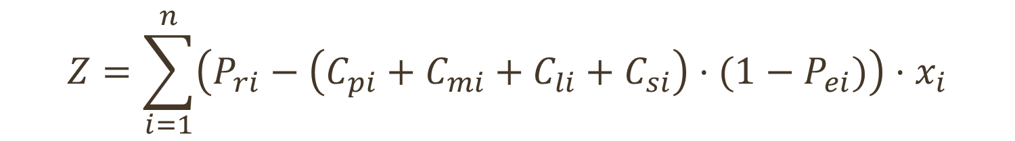
Mathematical Model Formulation
Our model aims to maximize net profit by determining the optimal quantity of each product to produce, while respecting operational constraints.
Decision Variables: Number of units to produce for each product.
Objective Function: Maximize total net profit :
Retail shelf space cost
$$Z=\sum_{i=1}^{n}{\left(P_{ri}−\left(C_{pi}+C_{mi}+C_{li}+C_{si}\right)⋅(1−P_{ei})\right)}⋅x_{i}$$
Retail price
Marketing cost
Penalty
Total net profit
Delivery and logistics cost
Number of units produced
Production cost
Penalty Term: Reflects product age, shelf space used by unsold stock, and demand mismatch.
$$P_{ei}=d_{base}⋅\left(\frac{age_{i}}{age_{max}}\right)⋅\left(\frac{s_{old,i}}{S_{max}}\right)$$

Slide 12
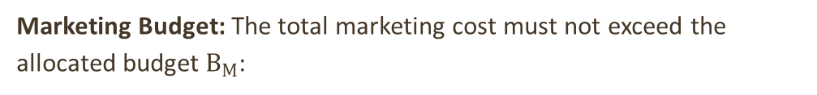
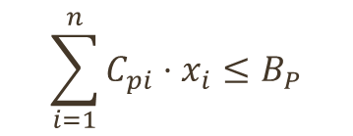
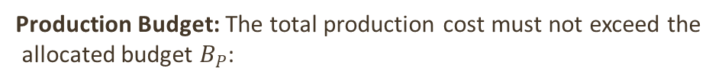
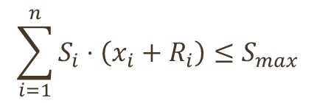
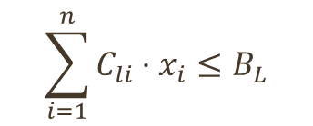
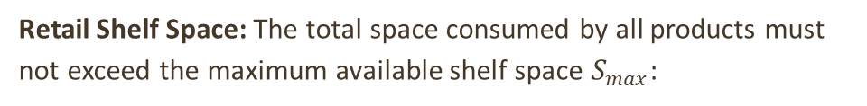
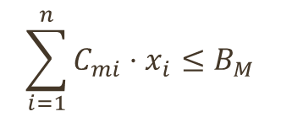
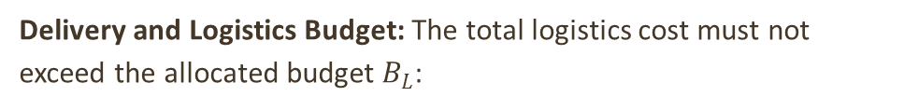
Constraints Handling
The model includes multiple real-world constraints:
Production Budget: The total production cost must not exceed the
allocated budget $B_{P}$:
Marketing Budget: The total marketing cost must not exceed the allocated budget $B_{M}$:
$$\sum_{i=1}^{n}{C_{pi}}⋅x_{i}≤B_{P}$$
$$\sum_{i=1}^{n}{C_{mi}}⋅x_{i}≤B_{M}$$
Delivery and Logistics Budget: The total logistics cost must not exceed the allocated budget $B_{L}$:
Retail Shelf Space: The total space consumed by all products must not exceed the maximum available shelf space $S_{max}$:
$$\sum_{i=1}^{n}{C_{li}}⋅x_{i}≤B_{L}$$
$$\sum_{i=1}^{n}{S_{i}}⋅\left(x_{i}+R_{i}\right)≤S_{max}$$

Slide 13
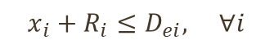

Constraints Handling
The model includes multiple real-world constraints:
Profitability and Demand Constraints
Demand Constraints: The total number of units for each product (newly produced plus remaining old stock) must not exceed the expected market demand:
Non-Negativity Constraint: All decision variables and costs must be non-negative:
$$x_{i}+R_{i}≤D_{ei}, ∀i$$
$$x_{i}≥0, ∀i$$
Profitability Constraint: Ensures that the total cost per unit does not exceed the discounted retail price, guaranteeing non-negative profit per unit:
$$C_{pi}+C_{mi}+C_{li}+C_{si}≤P_{ri}⋅\left(1−P_{ei}\right)$$

Slide 14









Genetic Algorithm Workflow
Complete GA Process: The workflow combines all components into an iterative optimization process.
Initialization
Create a random population of chromosomes
Evaluation
Calculate fitness for each chromosome
Selection
Choose parents using tournament selection
Crossover
Create offspring by combining parent chromosomes
Mutation
Introduce random changes to maintain diversity
Repair
Fix any constraint violations in new chromosomes
Replacement
Form new population with best solutions
Termination
Stop when reaching max generations or convergence

Slide 15
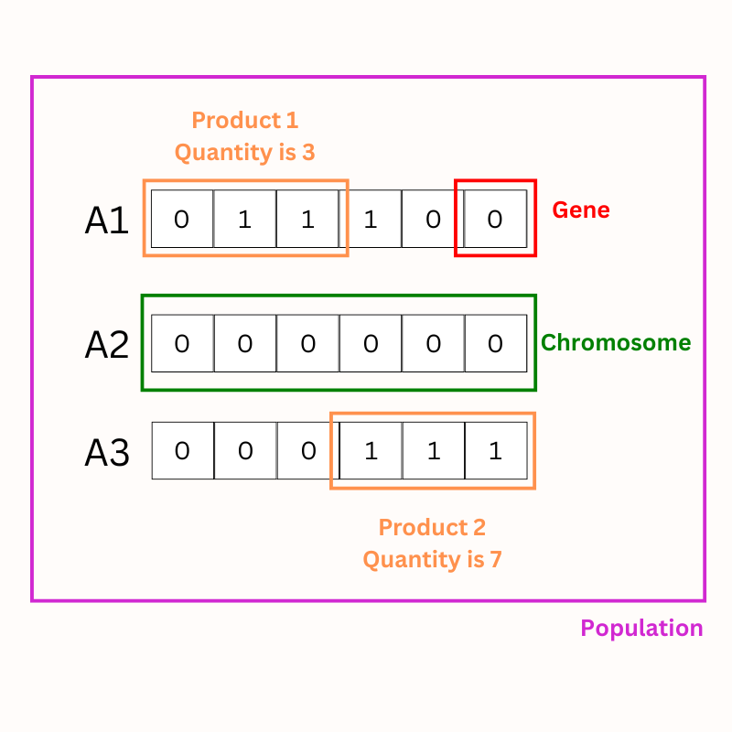
Chromosome Encoding in Genetic Algorithms

Slide 16




Key Components and Parameters
Selection
Crossover
Tournament selection.
One-point crossover between parents.
Mutation
Repair Function
Bit-flip mutation to introduce variation.
Ensures all constraints (budgets, shelf space, demand) are respected.
Key Parameters:
Population size = 50
Generations = 100
Crossover rate = 0.7
Mutation rate = 0.01

Slide 17
Repair Function in Genetic Algorithm
Purpose
The repair function ensures that a chromosome (solution) satisfies all the constraints of the optimization problem by adjusting its values as needed.
Core Mechanism
Demand Repair: Adjusts the quantities in the chromosome to ensure that they do not exceed demand constraints.
Budget Repair: Ensures the sum of production, marketing, and logistics costs remains within specified budget limits.
Feasibility Repair: Ensures that the total shelf space and demand constraints are not violated, even when the chromosome is adjusted.
Process Overview
Initial Decoding: The chromosome is decoded into a list of quantities.
Demand Repair: Quantities are adjusted based on the maximum demand, ensuring no violation.
Budget Repair: If budget constraints are violated, the function reduces quantities of products with the highest cost contribution until the budgets are satisfied
Feasibility Repair: A further check ensures that all other constraints (shelf space and total demand) are met.
Re-encoding: The adjusted quantities are encoded back into the chromosome in binary format.
Key Benefits
Ensures solutions generated by the algorithm are feasible.
Helps in maintaining balance between production, marketing, logistics budgets, and shelf space.
Impact on Optimization
Without the repair function, the solution might violate constraints, making it infeasible for practical use in real-world scenarios.

Slide 18
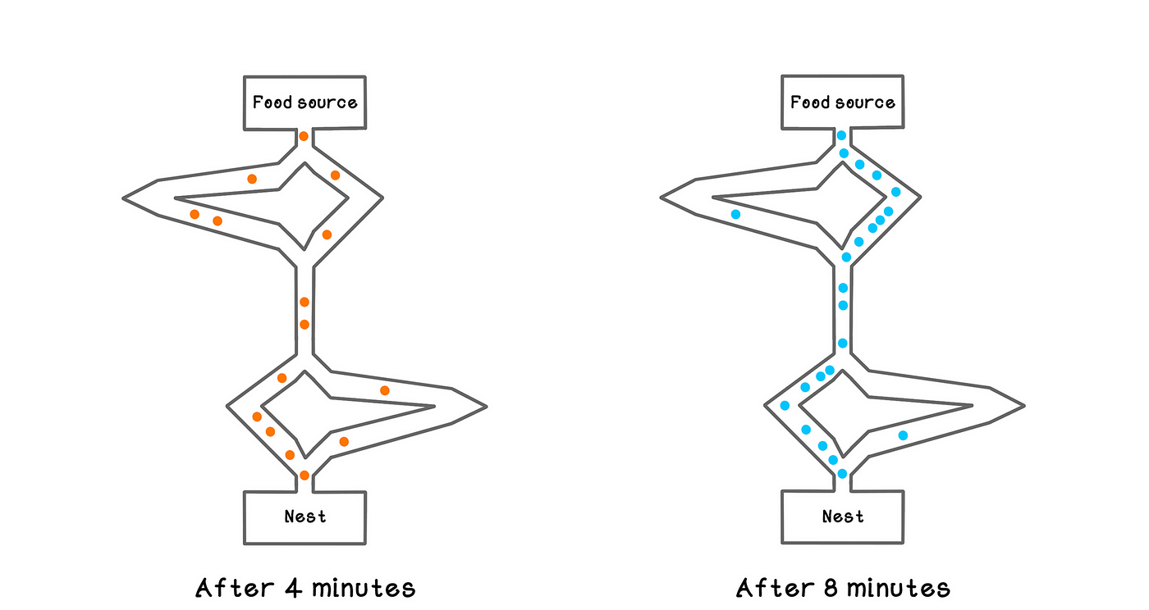
Ant Colony Optimization (ACO) Algorithm
What is ACO?
A probabilistic technique inspired by ants' behavior when finding paths between their colony and food sources.
How ACO Works
Initialize pheromone trails and heuristic information
Ants construct solutions probabilistically based on pheromone and heuristic values
Evaluate solutions against constraints
Update pheromone trails (deposit and evaporation)
Repeat steps 2-4 until termination condition
Key Principles
Indirect communication via pheromones
Positive feedback reinforces good paths
Distributed computation with multiple agents
Balance between exploration and exploitation

Slide 19



Main Functions Summary
Check constraints
Ant colony optimization
Run aco
Checks if a solution meets all budget and capacity limits
Core algorithm that:
Wrapper function that:
Creates ants to explore solution space
Loads data from Excel file
Sets up algorithm parameters
Evaluates solutions against constraints
Calls ant_colony_optimization()
Formats and returns results
Updates pheromone trails
Returns best solution found

Slide 20
Algorithm Parameters
alpha:
5.0
Pheromone influence
beta:
10.0
Heuristic influence
rho:
0.3
Evaporation rate
n_ants:
100
Number of ants
n_iterations:
10
Maximum iterations
Q:
0.5
Pheromone coefficient
max_no_improvement:
5
Early stopping threshold

Slide 21

Simulation Setup
Tested product portfolio sizes: in Range from 10 to 500
Algorithms: Genetic Algorithm (GA), Ant Colony Optimization (ACO), GAMS
Goal: Maximize profit through optimal product mix

Slide 22
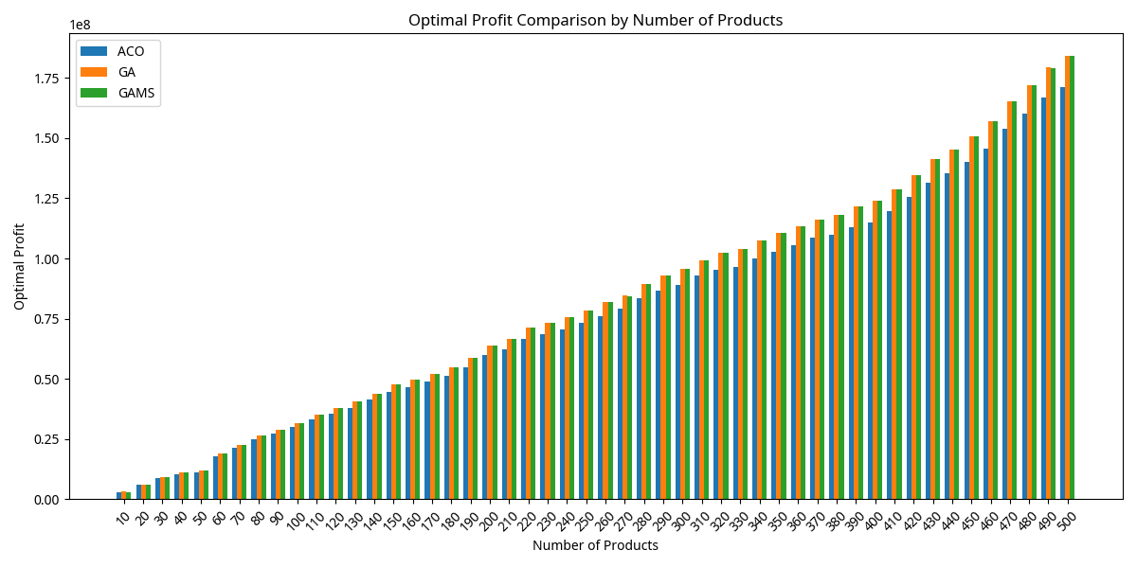
Net Profit Comparison
$82.7M
$82.6M
$77.3M
GAMS
GA
ACO
Average Profits (10–500 products)
Average Profits (10–500 products)
Average Profits (10–500 products)
GA excels at large-scale, hitting $184M at 500 products

Slide 23
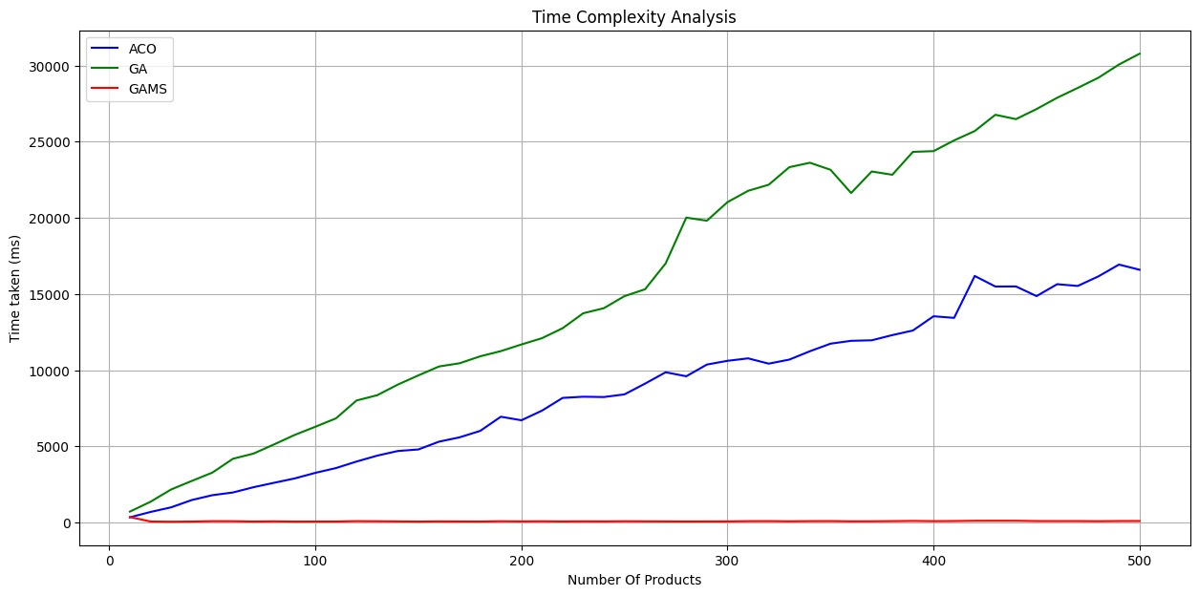
Time complexity graph
GAMS: ~88.8 m
GA: Avg 16,022 ms, scales quadratically
ACO: Avg 8,679 ms, stable execution

Slide 24
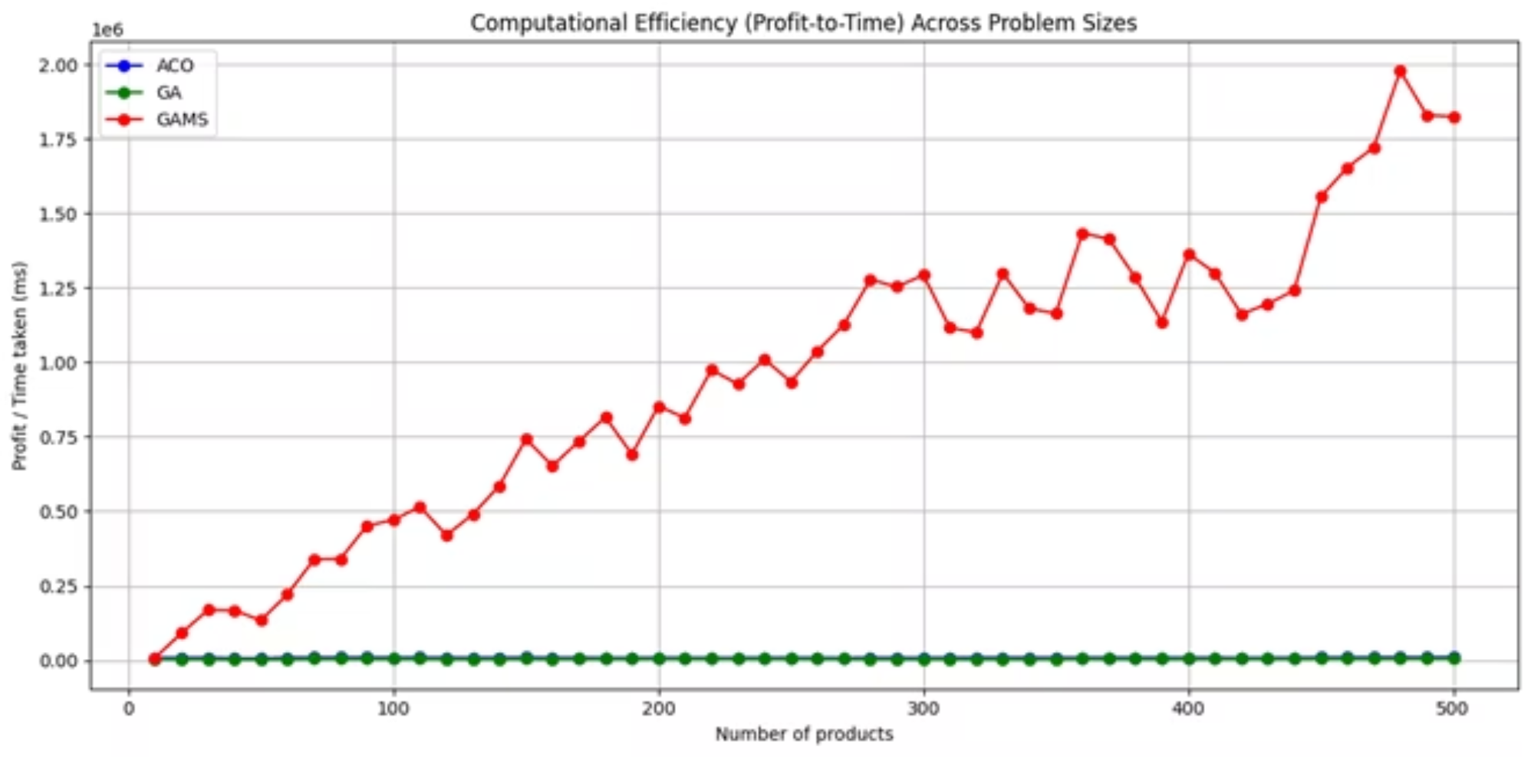
Efficiency: Profit/Time
GAMS is most efficient: Avg. efficiency ~2,000,000
GA and ACO: Efficiency <10,000
GAMS consistently fast and scalable

Slide 25
Algorithm Performance & Managerial Insights
1. Profit vs Problem Size
2. Managerial Implications
3. Insights & Recommendations
Algorithm Performance
Algorithm Use Case
No single best algorithm for all cases
GAMS Linear growth, highest at 500 products
GAMS Real-time, structured problems
Choose based on problem complexity and speed
GA Strong, slightly below GAMS at extremes
GA Complex, strategic planning
Hybrid approaches may yield better results
ACO Stable, medium-scale problems
ACO Steady increase, but lower peak profits

Slide 26
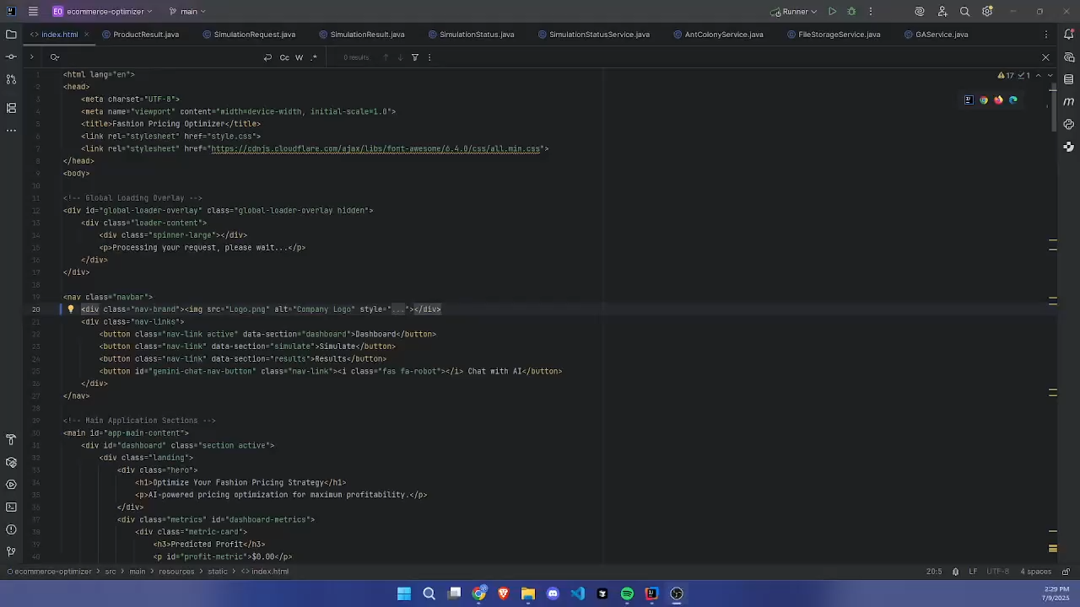
Demo: Simulated UI and Backend

Slide 27
Future Work
Multi-Objective Optimization
Introduce models that balance profitability with sustainability, customer satisfaction, and risk mitigation.
Product Category Constraints
Allow constraints by product type (e.g., limit on accessories, minimum production of high-margin items).
Real-Time Data Integration
Connect with real-time sales, inventory, and marketing systems to allow live simulation updates.

Slide 28
Any Questions?

Slide 29
Thank you for your time and attention!

